Slide 1
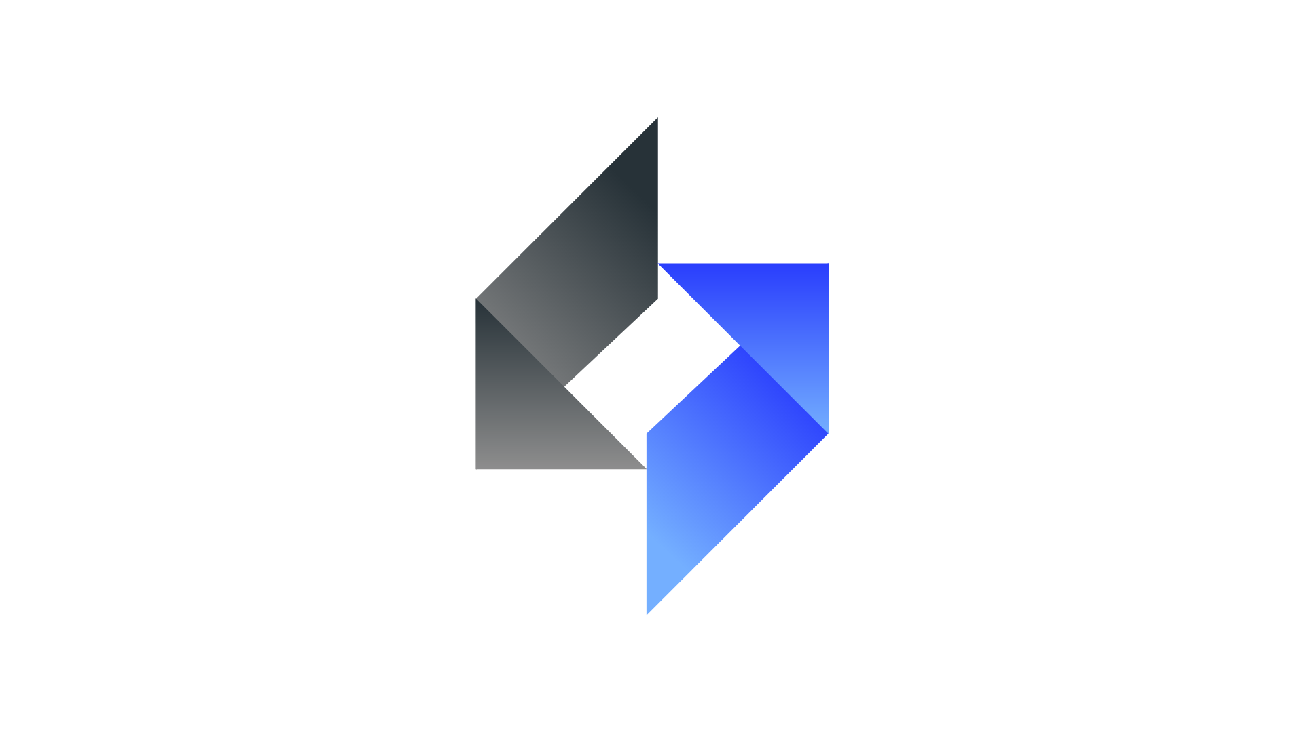
Annual SWITCH Convention for Innovation
Team Name :- TheDevLoopers
Team Member’s :- 1.K Nirmal Kumar
2.Dipankar Maharana
Info :-
OneMED is an android application created to establish a connection between doctors, pharmacy and patients. Recent days due to the unprecedented pandemic, it is getting more difficult to find a doctor and fix appointment with the patient who were unable to go to hospital to visit doctor. With help of this app, patients can easily post their issues with details along with their requested appointment time. Doctor can view those issues and fix their appointment time from the app. The whole data of the patient would be patient would be stored in the cloud storage and there will be no need of having a physical paper prescribed meds or his information where in the app will show the patient details, meds prescribed and for how many days and the pharmacy has the access to it .

Slide 2
Problem statement
Existing systems provide the basic functionalities needed to be handled in a hospital management environment. In the existing system all the patient details, doctor availability details and regarding the tests done to the patients prescribed by the doctor is maintained manually by the receptionist. There are also many loopholes when we look at the security of the system.
Patients request for appointment for any doctor. The details of the existing patients are retrieved by the system. New patients update their details in the system before they request for appointment with the help of assistant. The assistant confirms the appointment based on the availability of free slots for the respective doctors and the patient is informed. Assistant may cancel the appointment at any time.
The information is very difficult to retrieve and to find particular information like- E.g. - To find out about the patient’s history, the user has to go through various registers.
Various changes to information like patient details are difficult to make as paper work is involved.
Preparation of accurate and prompt reports: - This becomes a difficult task as information is difficult to collect from various registers.
There can be manual error and calculation error at the time of billing at the pharmacy so the this can make the tasks much more easier and in an efficient way.
These are the main disadvantages of the existing systems that are to be overcome in the proposed model

Slide 3
Proposed Solution
OneMED is an android application created to establish a connection between doctors , pharmacy and patients and minimise the pen-paper work.
Recent days due to the unprecedented pandemic, it is getting more difficult to find a doctor and fix appointment with the patient who were unable to go to hospital to visit doctor. With help of this app, patients can easily post their issues with details along with their requested appointment time. Doctor can view those issues and fix their appointment time from the app. Once their appointments were confirmed, app will automatically set up an alarm to both patient and doctor who accepted their appointment. By this app both the patient and doctor doesn’t have to be physically present at the same place, both of them can conveniently attend call at their different places and the patient health records will be stored in the cloud so there is no need for him to come with his reports.
This app is created using android studio and code is written using java. We used Firebase Realtime Database to store the data of the patient, doctor and appointment from which the app communicates. We included Material design dependence to enhance the appearance of the app. To establish a secured authentication, we used firebase authentication.

Slide 4
Proposed Solution
OneMED is designed for multi-speciality hospitals, to cover a wide range of hospital administration and management process of patient-centric system. It is an integrated end to end Hospital Database Management System that provides relevant information across the hospital to support effective decision making, patient medical record management and pharmacy billing in seamless flow

Slide 5
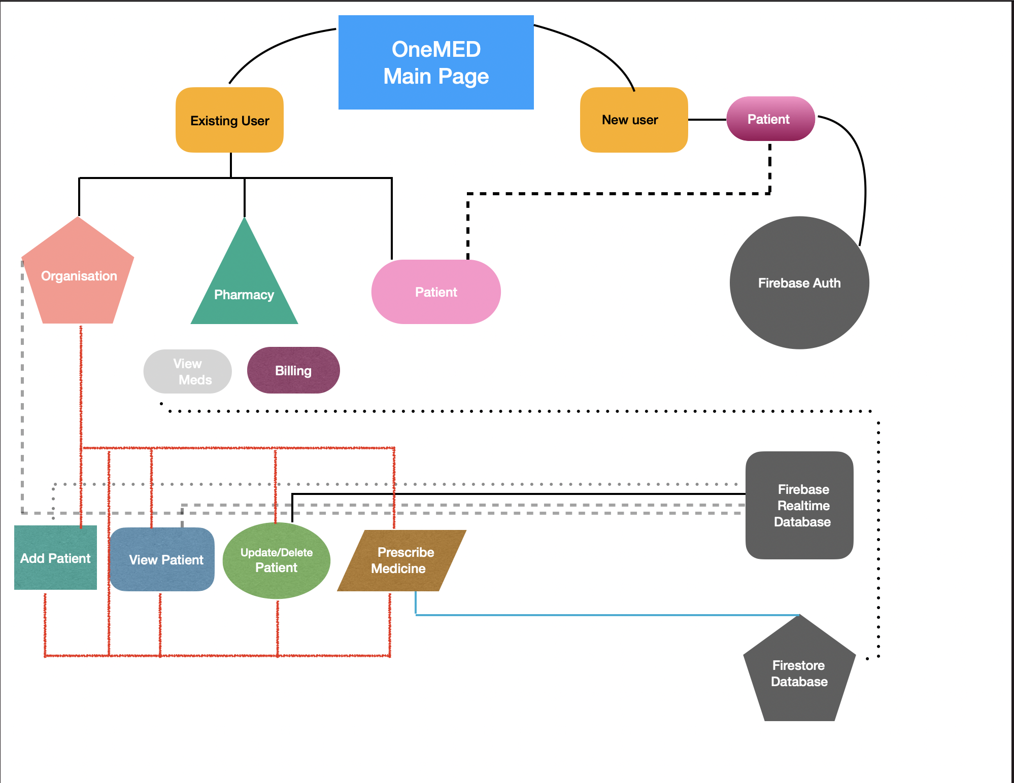
Flow Chart:

Slide 6
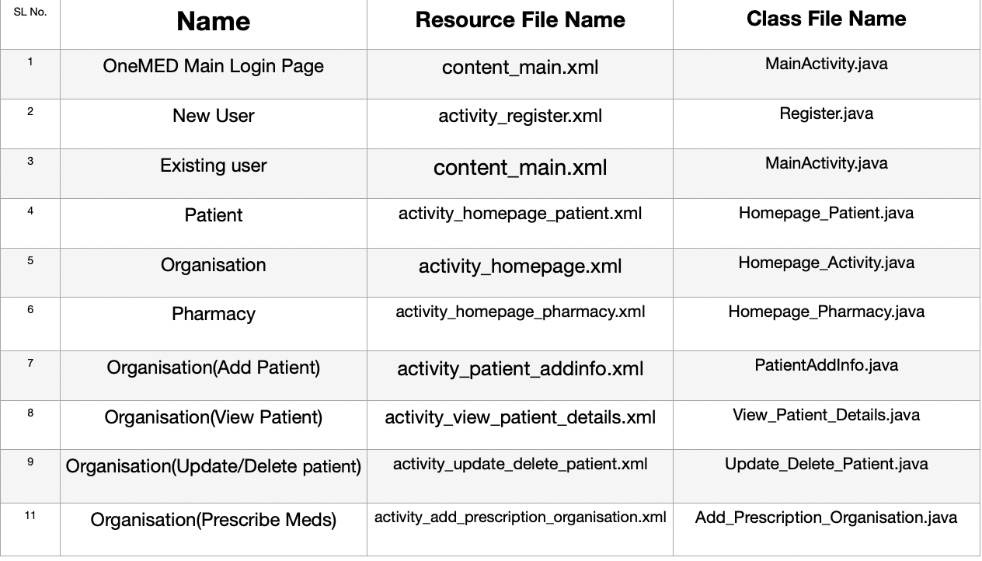
Resource File & Class Name

Slide 7
Tech Stack :-
1. Android Studio
2. Java
3. FireBase Realtime Database
4. FireBase Authentication
5. FireBase Cloud Firestore
Drive Link’s :
OneMED G-Drive
GitHub Repository Link:
OneMED GitHub Repository

Slide 8
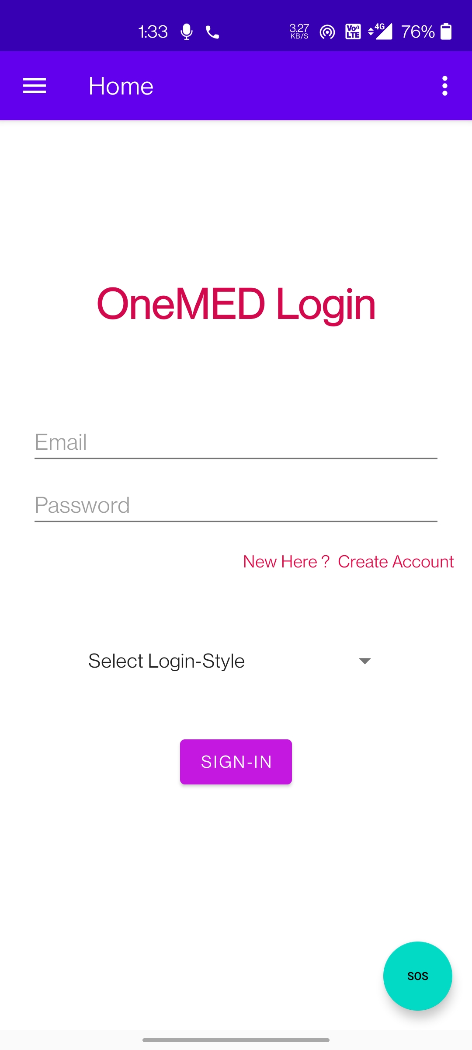
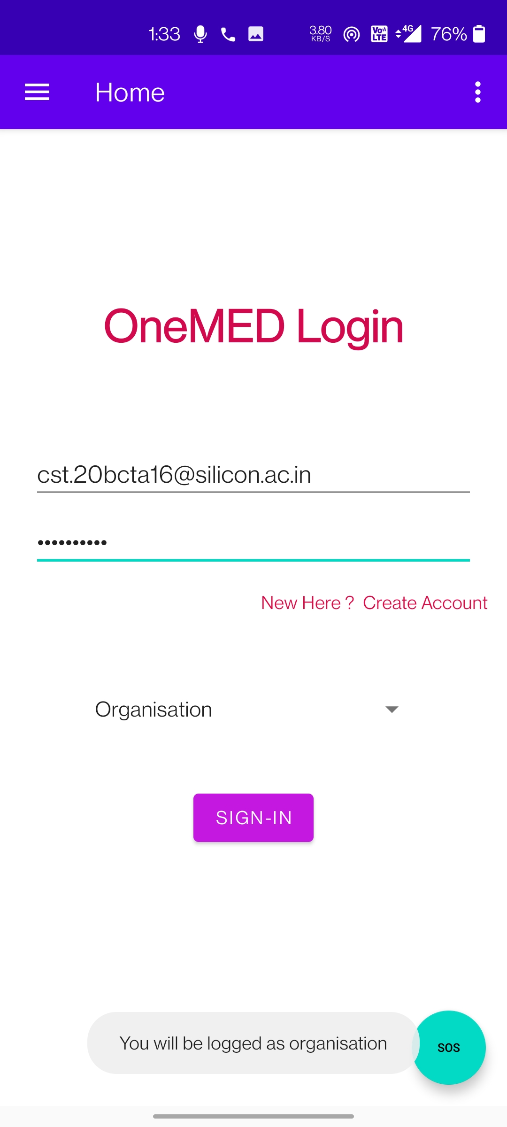
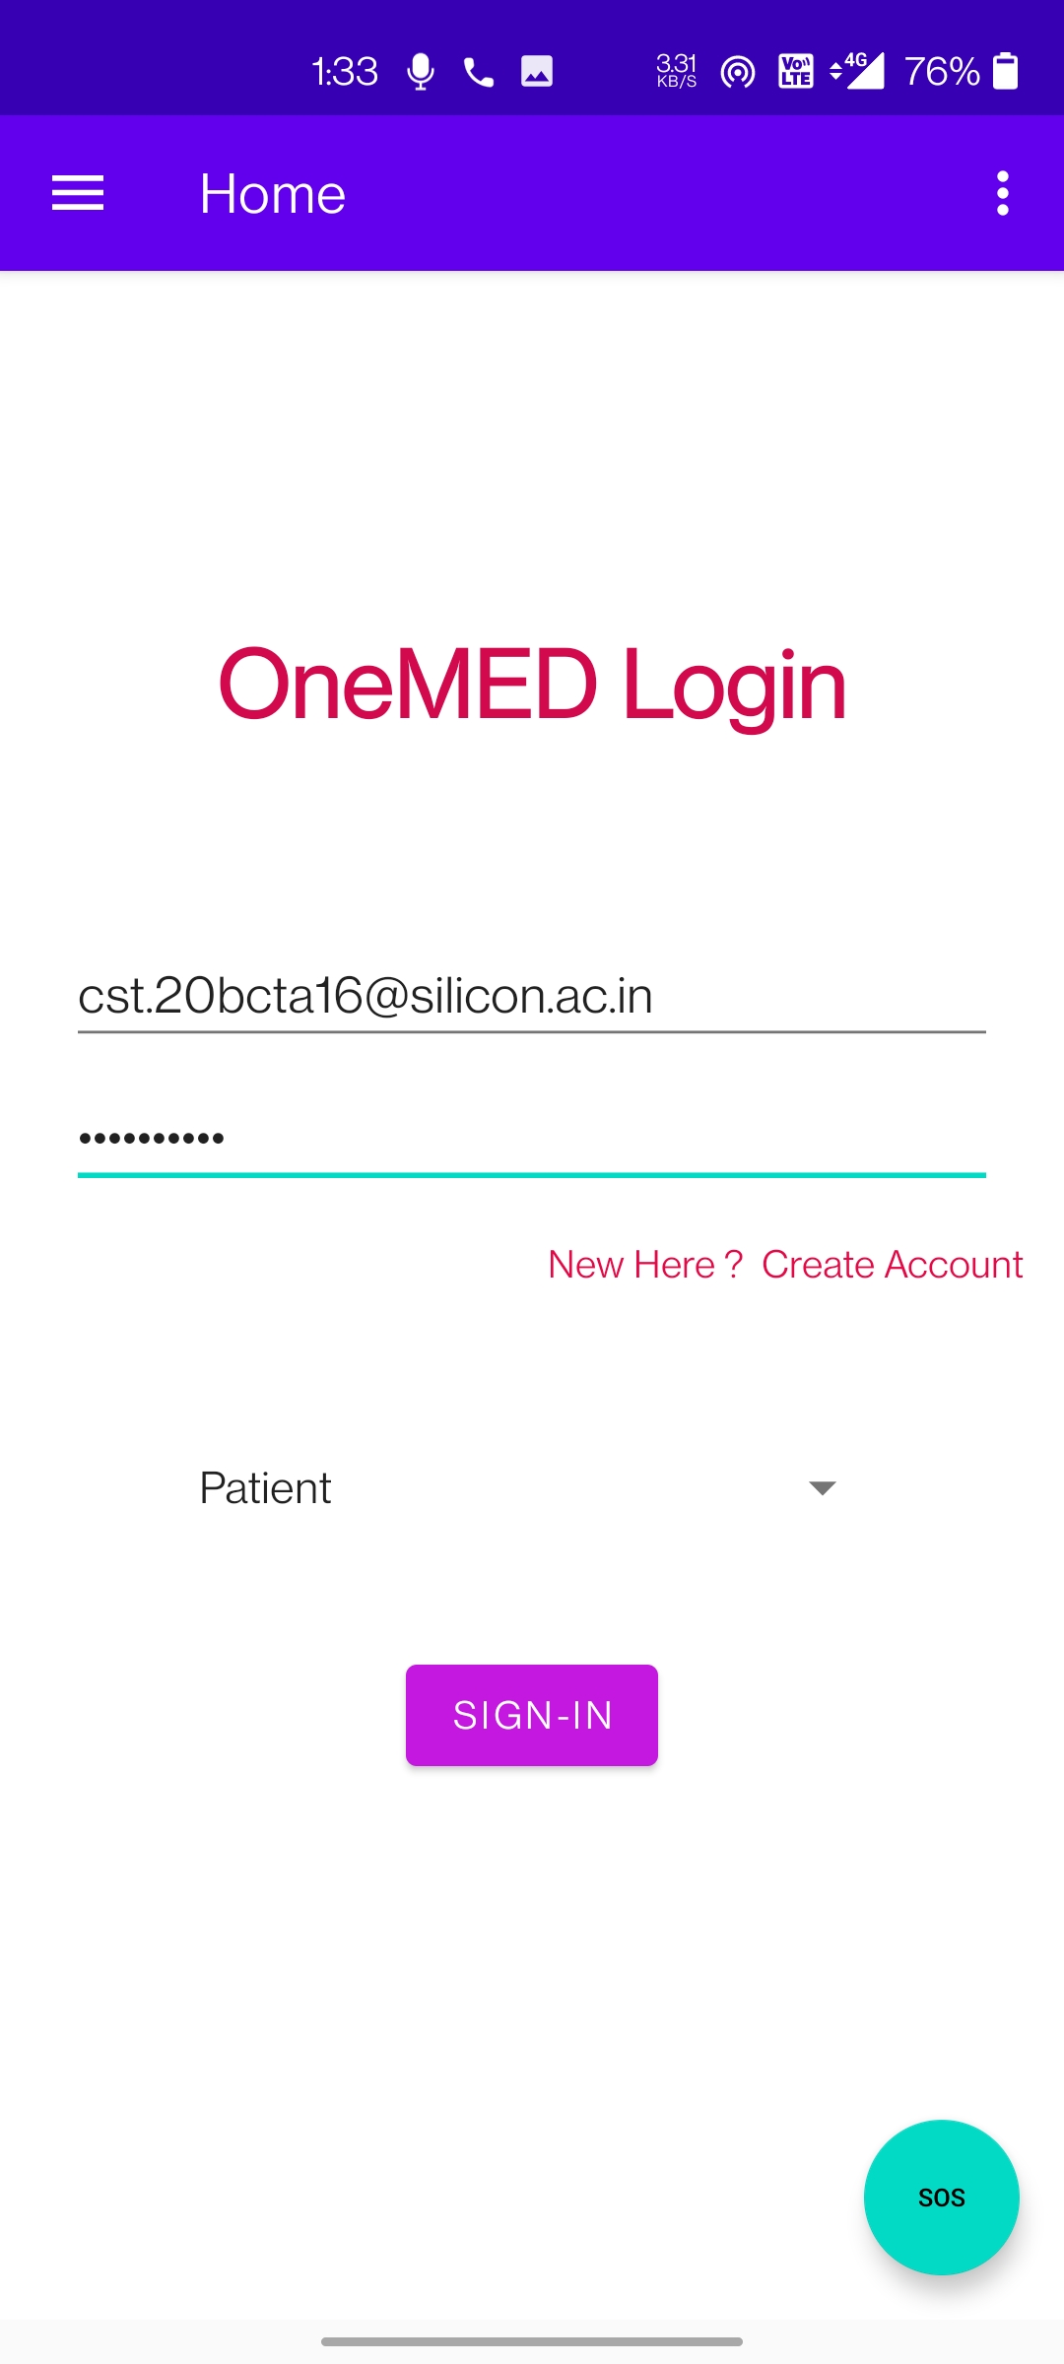
Login Layout’s :
Class : MainActivity.java
Layout: content_main.xml

Slide 9
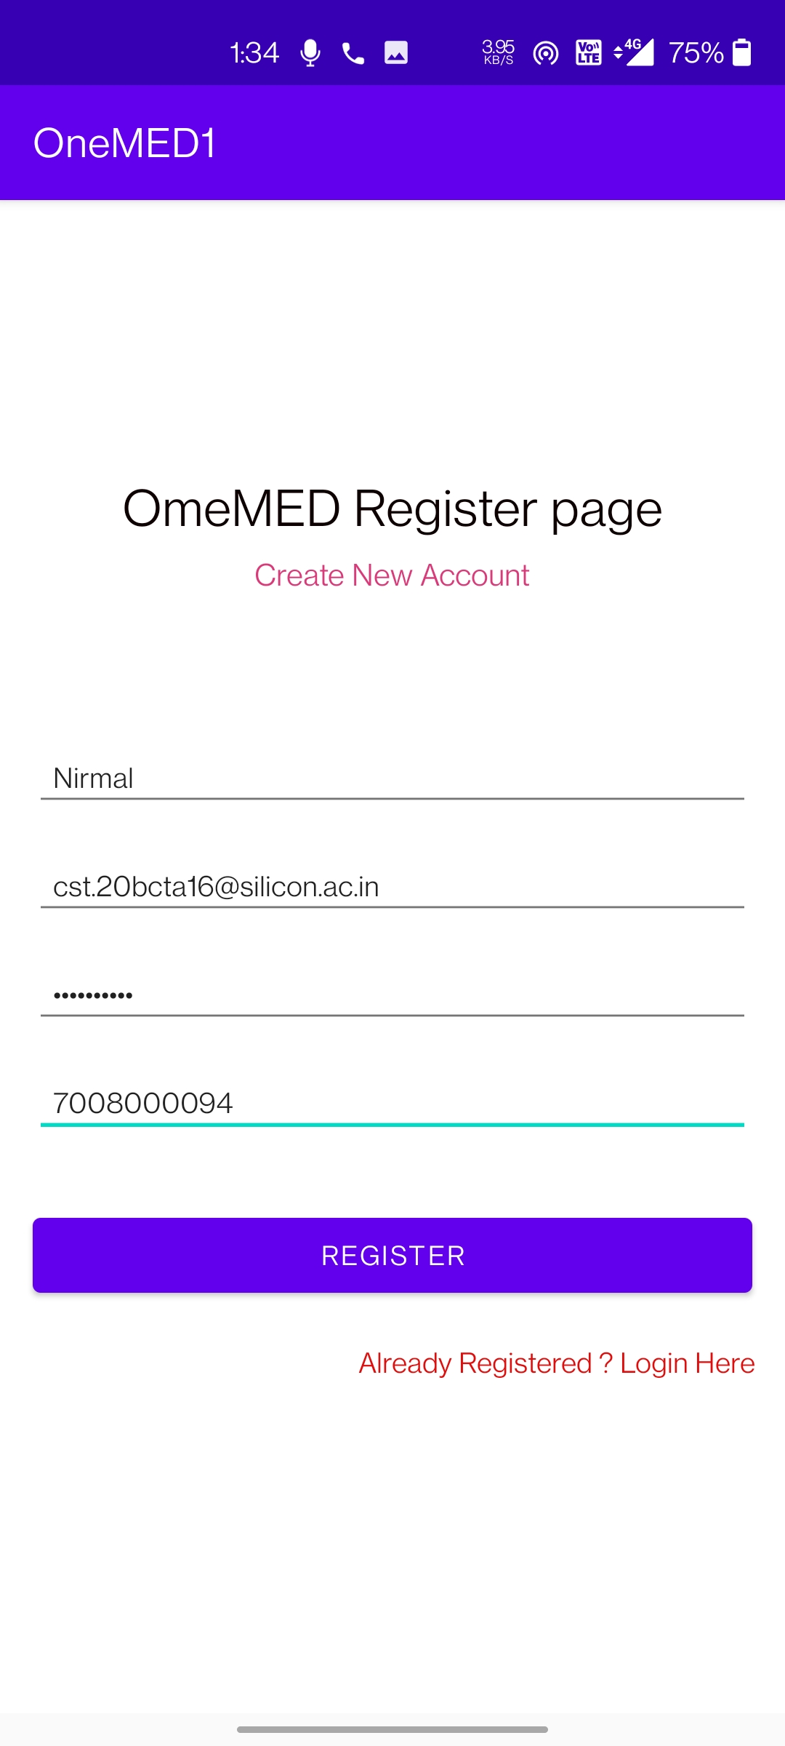
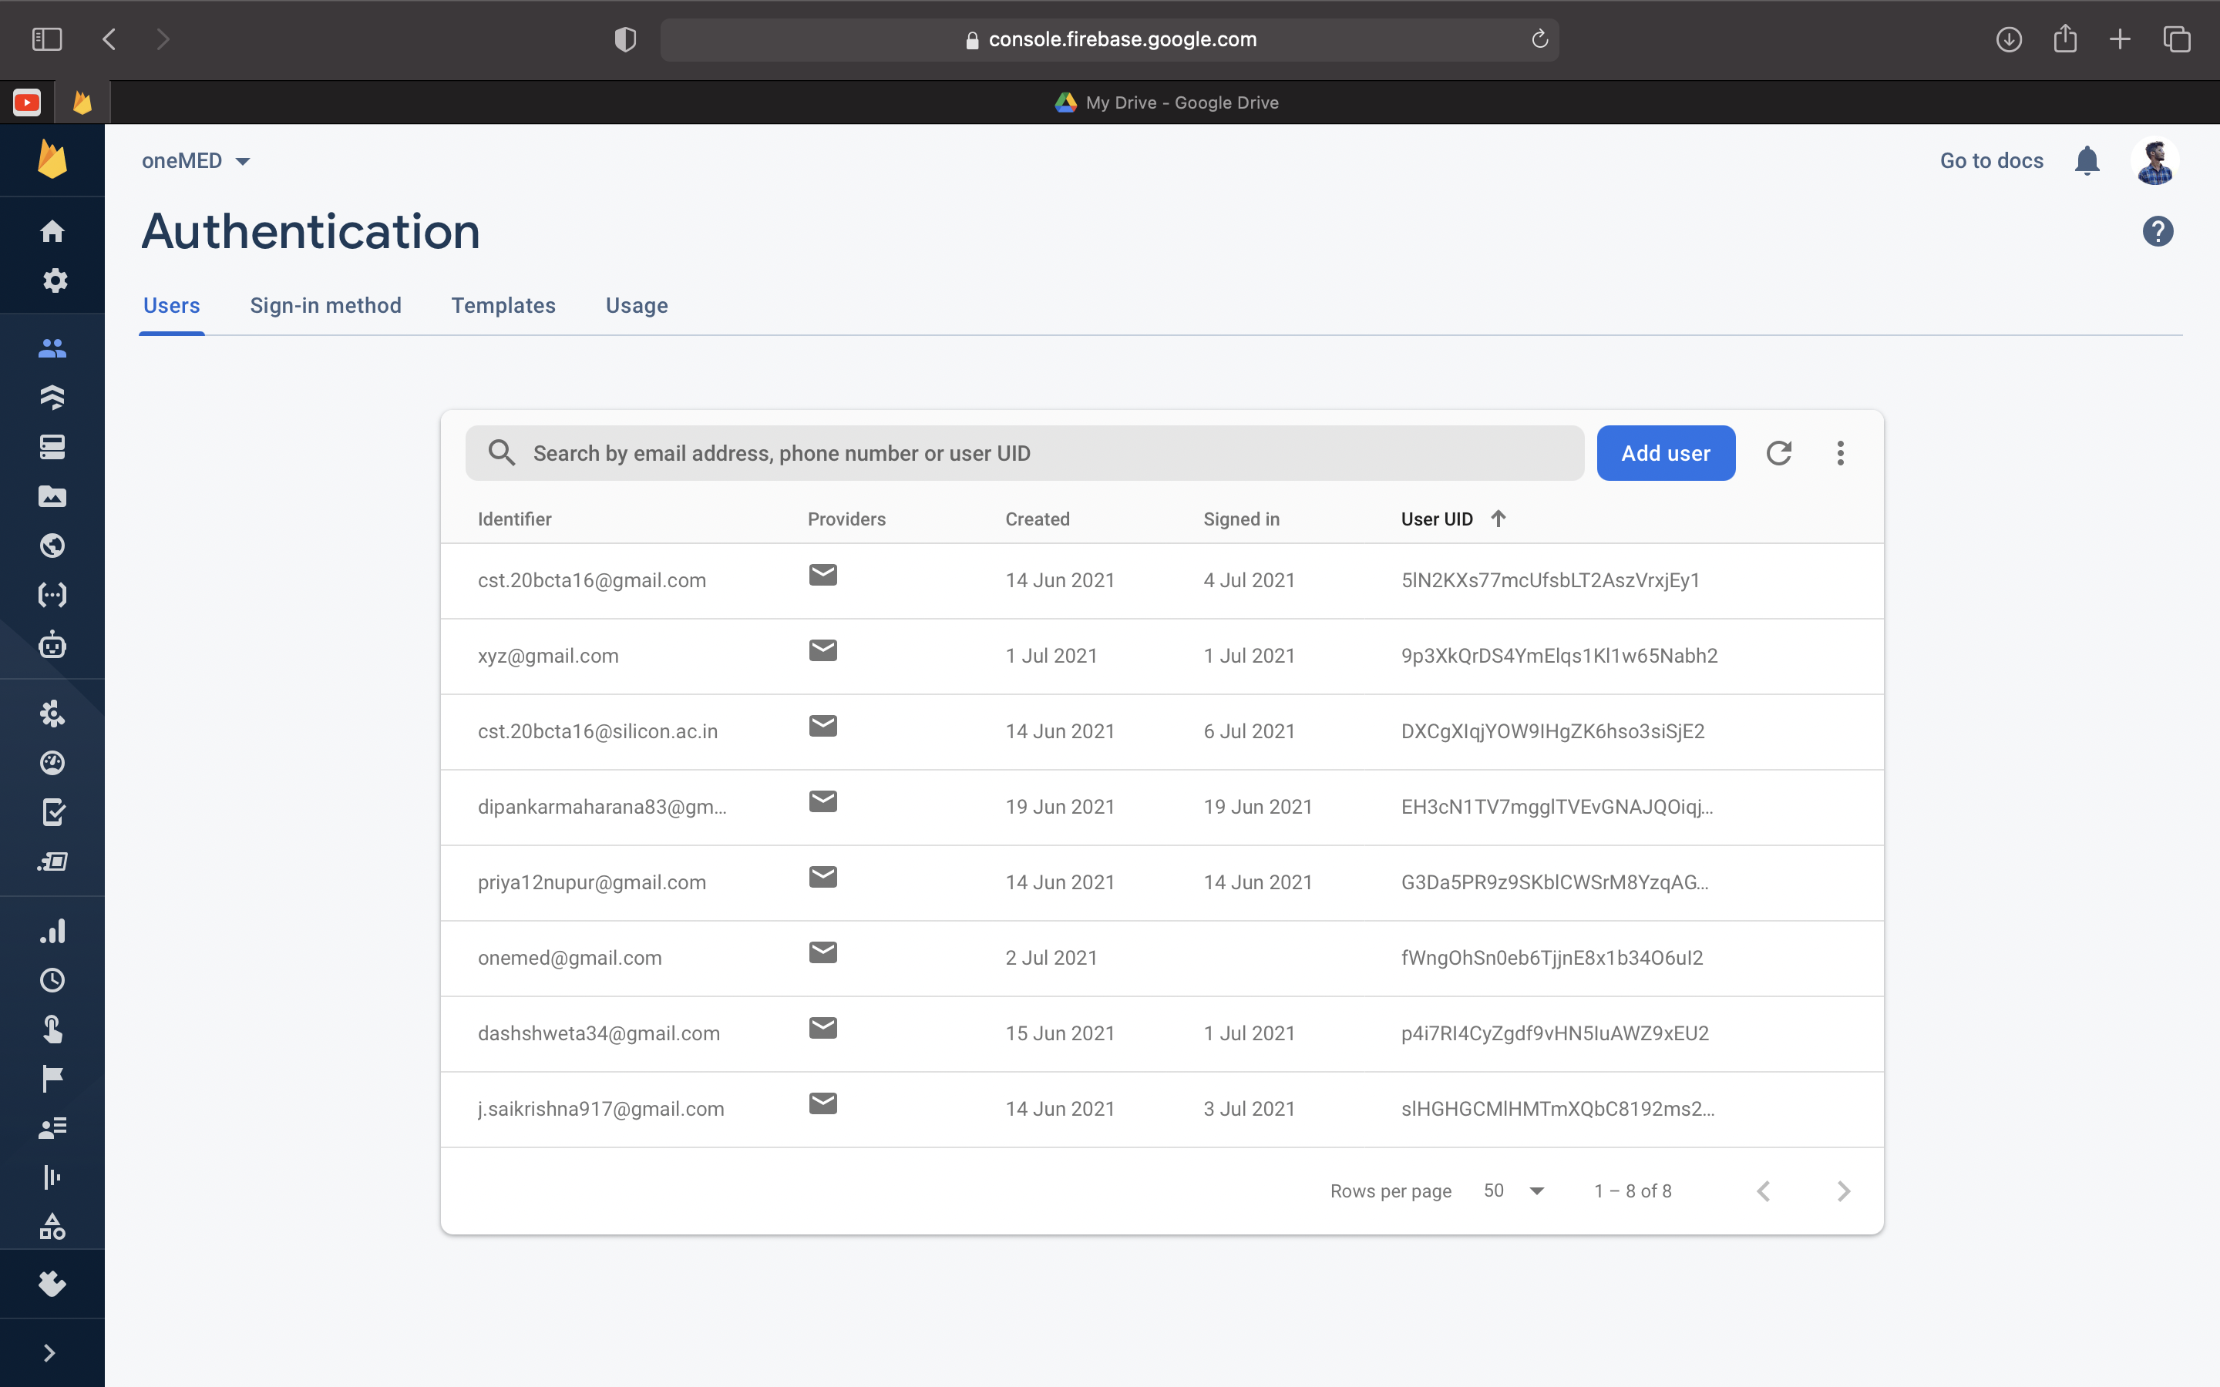
New User Layout’s :

Slide 10
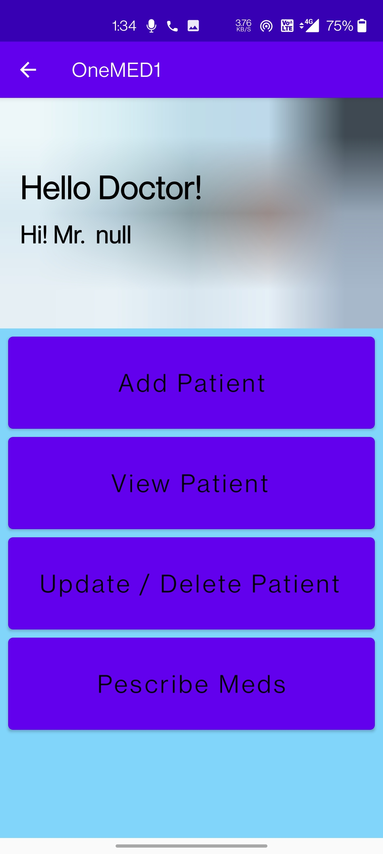
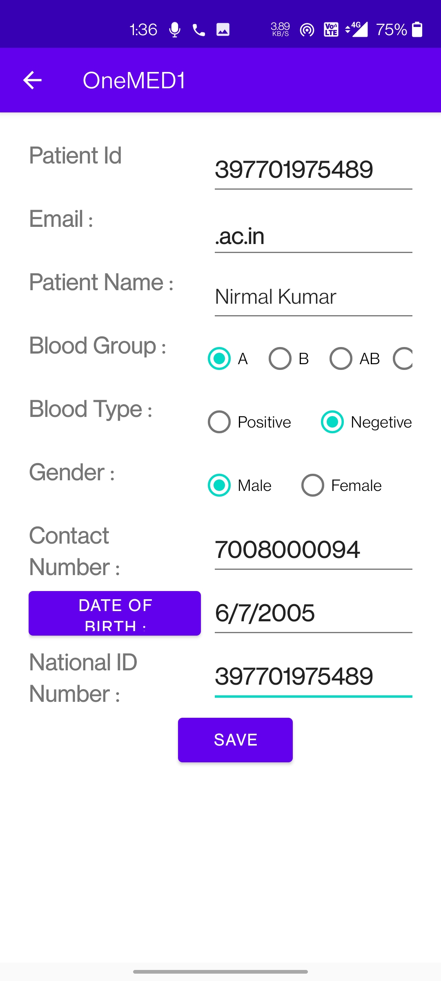
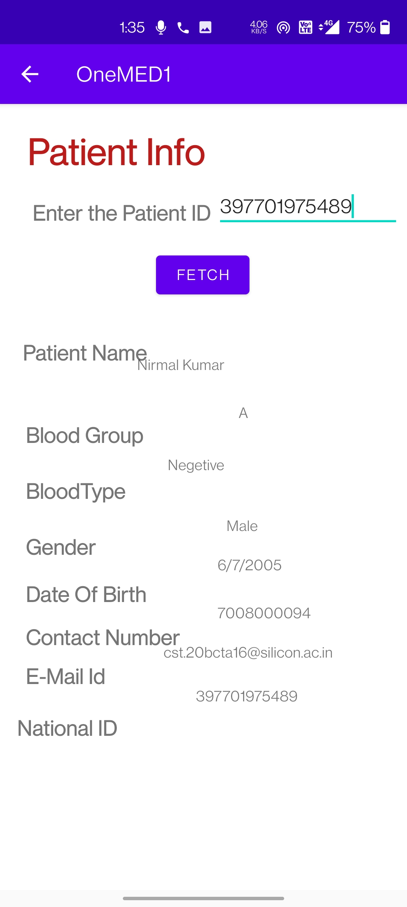
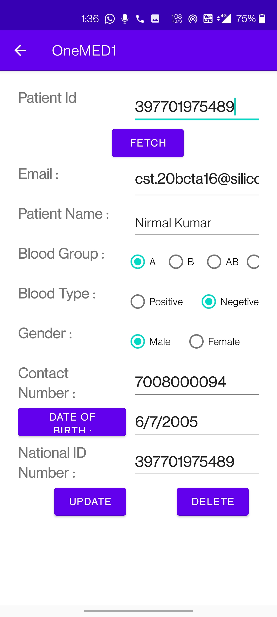
Organisation Layout’s :
Class: Homepage_Activity.java
Layout: activity_homepage.xml
Class: PatientAddInfo.java
Layout: activity_patient_addinfo.xml
Class: View_Patient_Details.java
Layout: activity_view_patient_details.xml
Class: Update_Delete_Patient.java
Layout: activity_update_delete_patient.xml

Slide 11
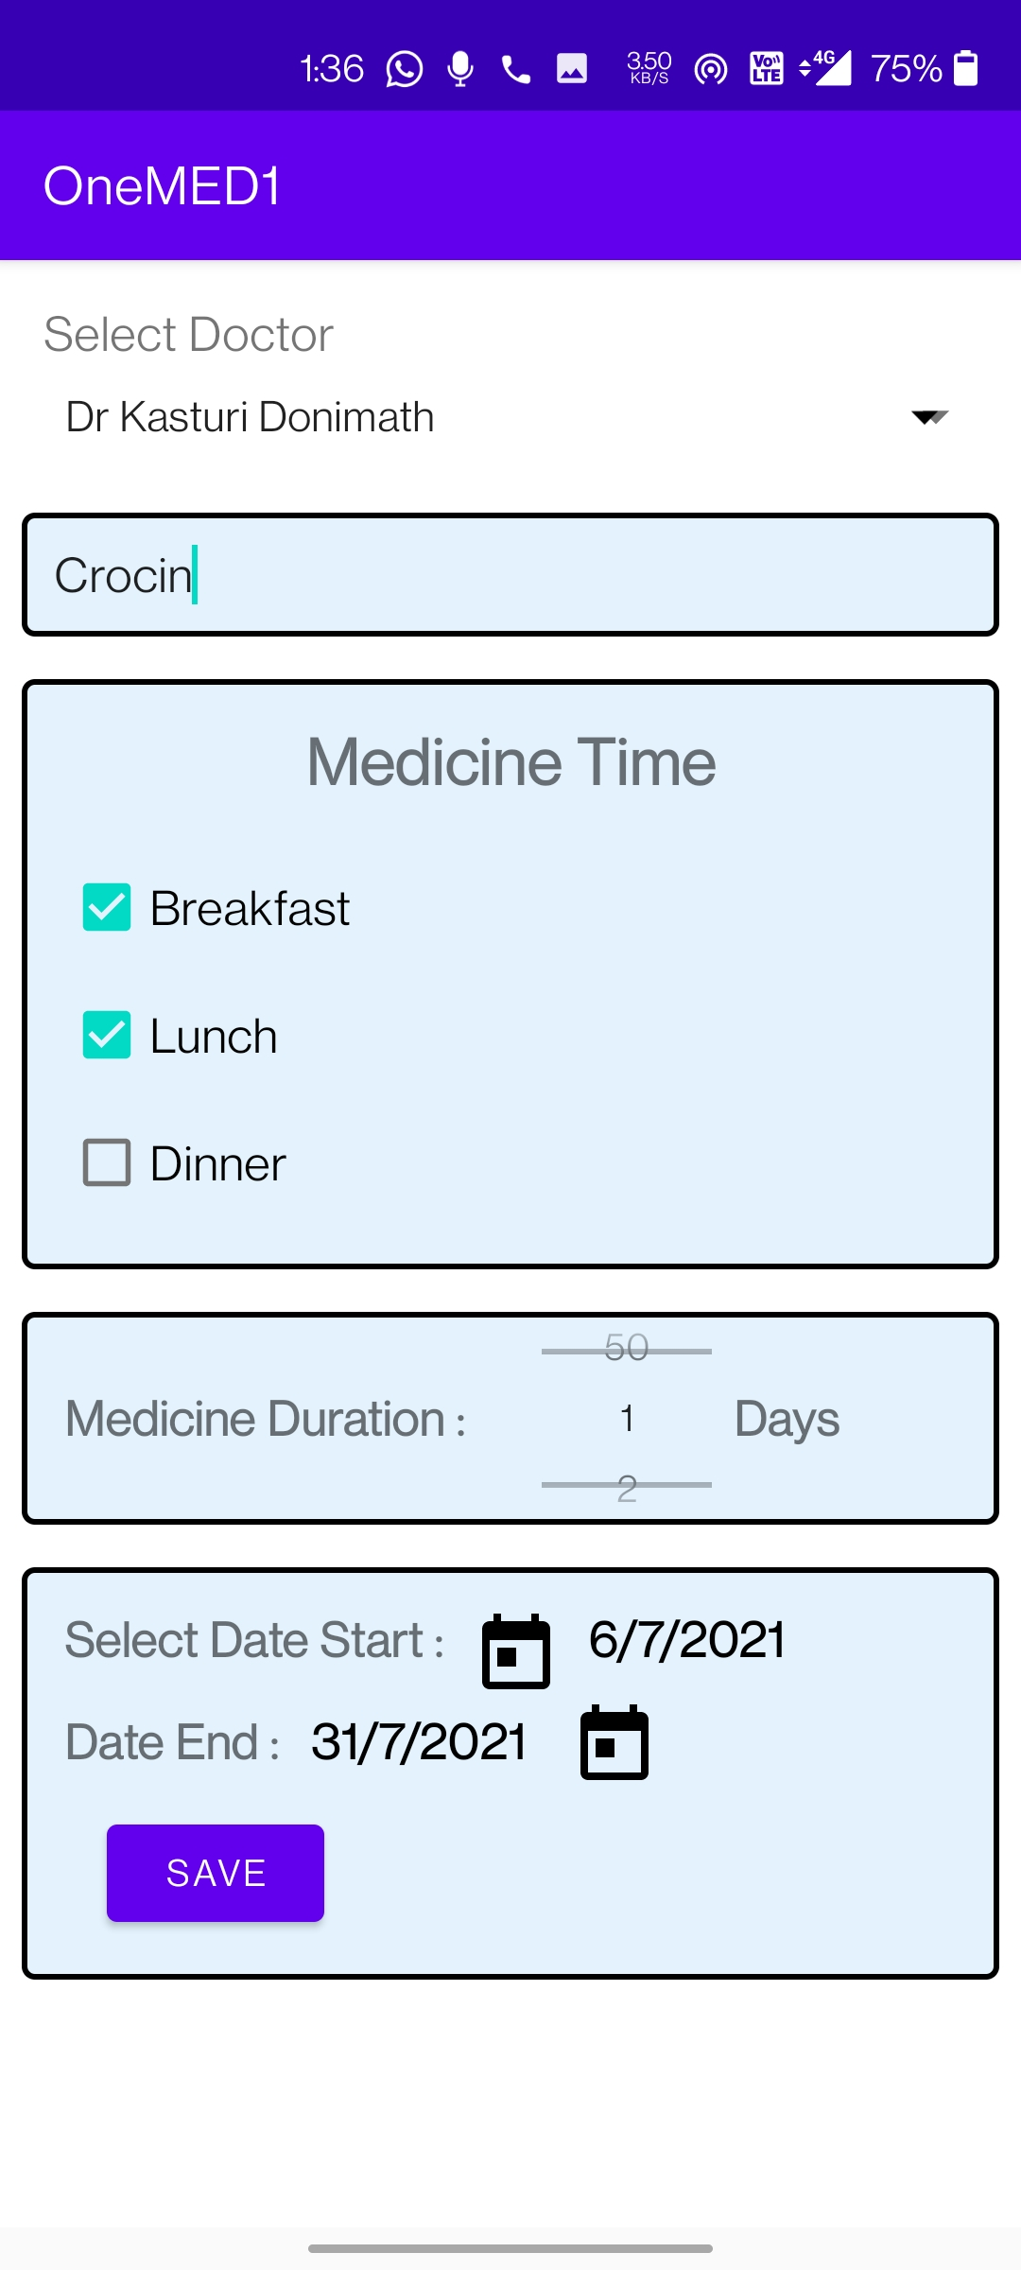
The Prescribed medicine data is stored in the firestore, Firestore is a NoSQL document database built for automatic scaling, high performance, and ease of application development. While the Firestore interface has many of the same features as traditional databases, as a NoSQL database it differs from them in the way it describes relationships between data objects. It can store multiple type of values like String, int, boolean, array, geo-location, date which gives us an advantage over realtime database and the further development will include the display of the prescribed medicine in the recycler view. The Prescribed medicines will be shared to the pharmacy where in the patient can easily buy the Meds from the pharmacy without carrying any physical prescription. The will implement the Idea of appointment scheduling and confirmation where in the patient appointment can be scheduled by him without visiting the hospital and with no third person involving in between.
Organisation Layout’s :
Layout: activity_add_prescription_organisation.xml
Class: Add_Prescription_Organisation.java

Slide 12
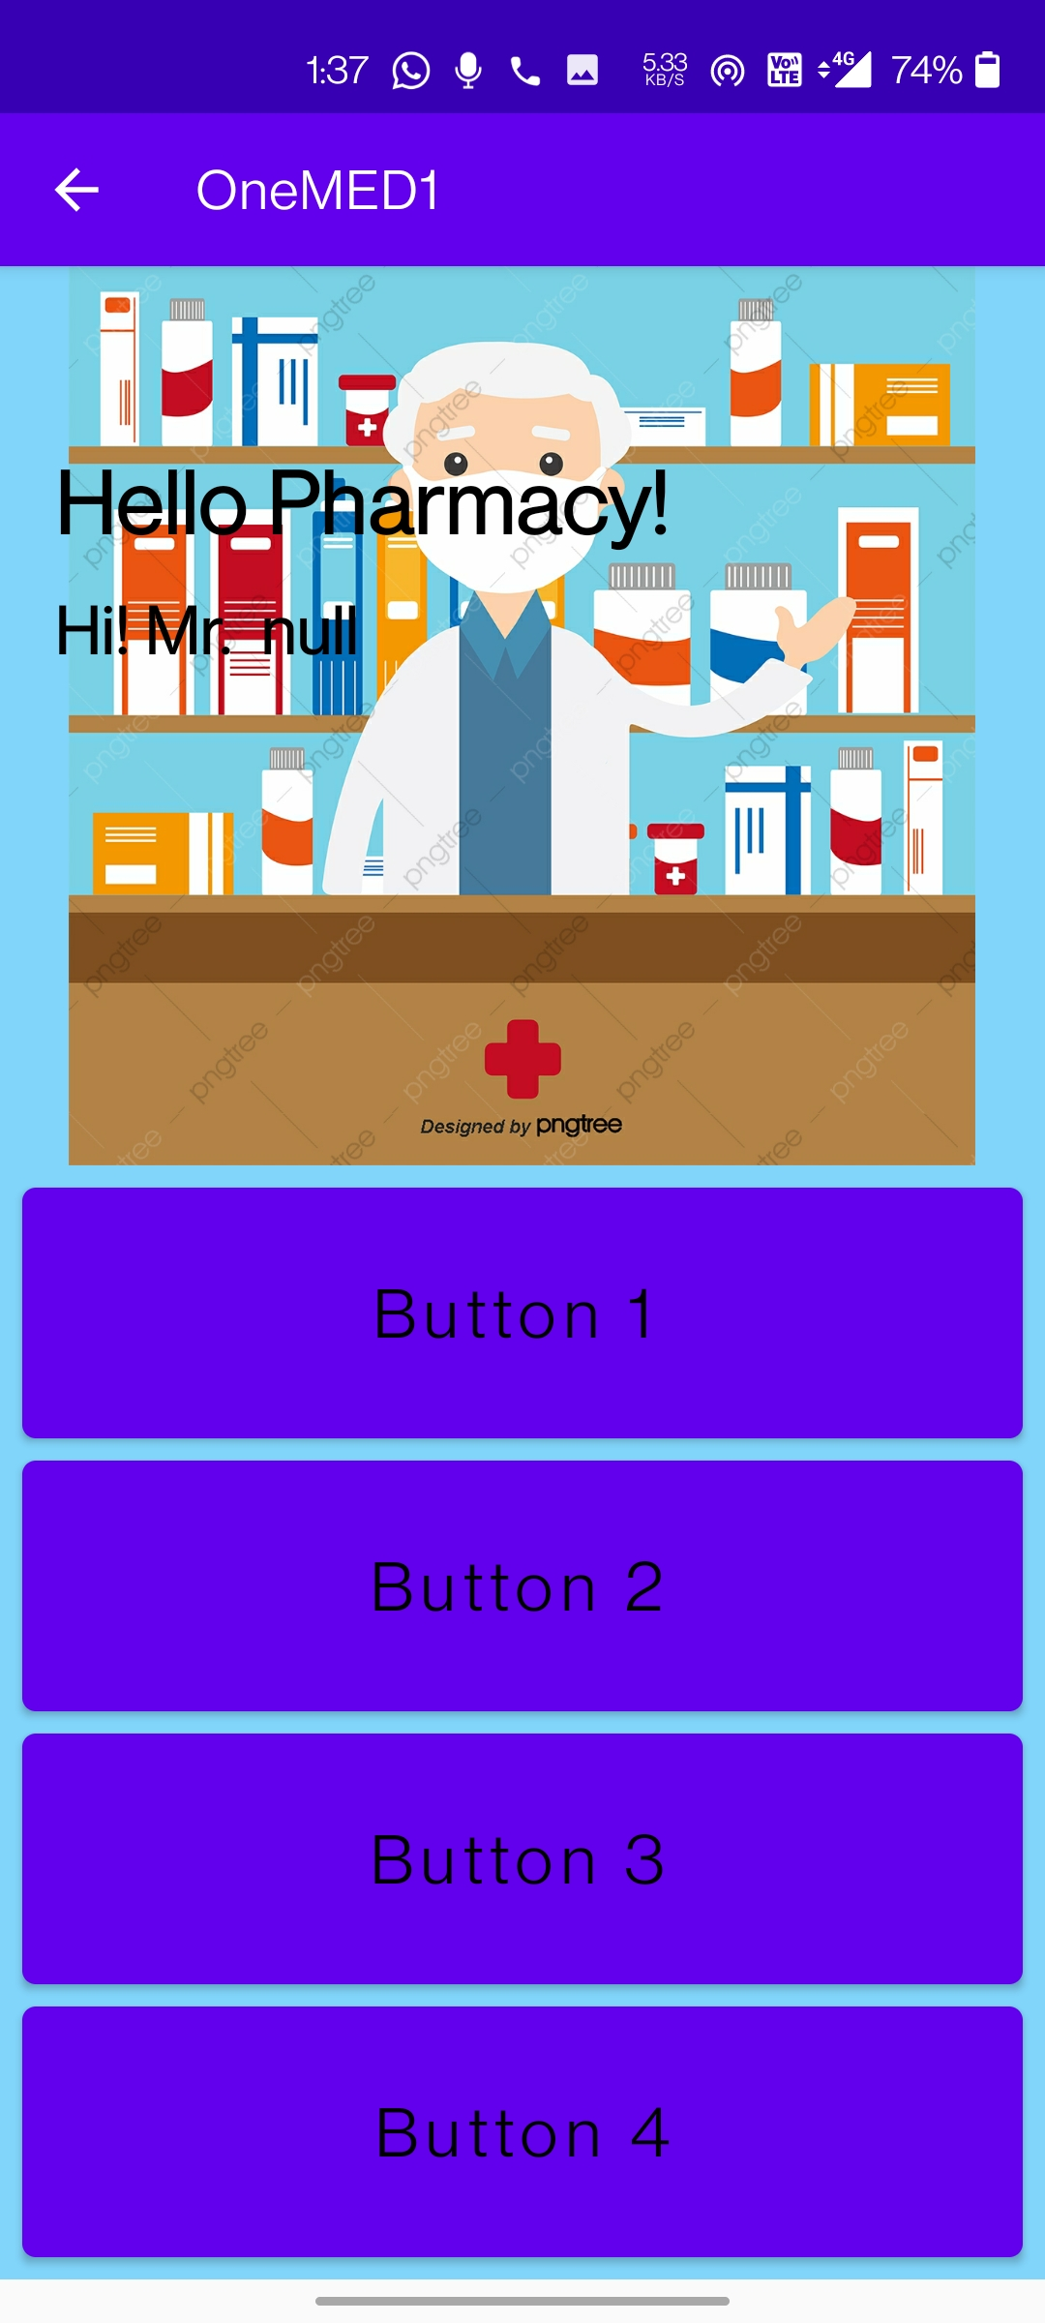
Pharmacy Layout :
The future scope of the Pharmacy will include adding a billing console where the pharmacy would be able to generate the bill and can update in the patient database and the data pass will be restricted where he will be only able to see the meds prescribed, patient id and the patient name and the other details can’t be accessed of the user privacy
Layout: activity_homepage_pharmacy.xml
Class: Homepage_Pharmacy.java

Slide 13
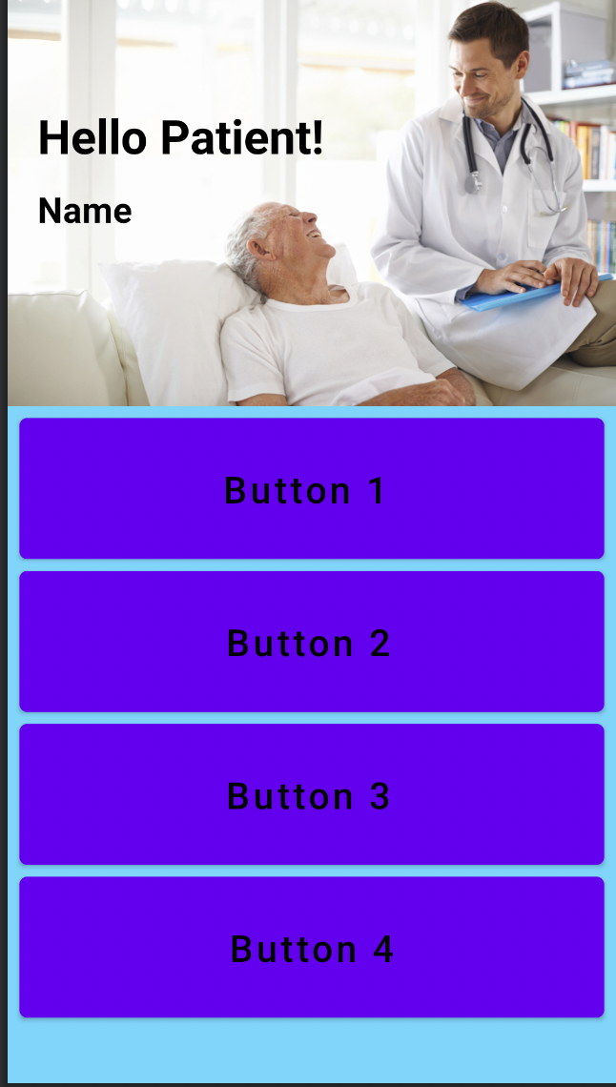
The further development will include where in the user can call the hospital on an emergency in which an explicit intent will be added to place a call, The patient can be able to view his info and the prescribed meds and also he can schedule an appointment with the doctor, where in the doctor has the authority to accept or decline the appointment after the doctors confirm the appointment, the patient would be able to See the prescribed meds and for how many days, and the patient can even see his health records which will be stored in the Firebase cloud.
Patient Layout :
Layout: activity_homepage_patient.xml
Class: Homepage_Patient.java

Slide 14
FireBase Authentication :
Firebase authentication is a service provided by google to enable secure authentication to our application that we are building. To enable firebase authentication, we need to include google-services.json file to the root of our directory. This file can be downloaded from the firebase console and we need to include the dependencies to our build.gradle file to access all the services provided by google to our project. There are many types of authentications like email, phone, google and github. In this project I have used email and password type of authentication.

Slide 15
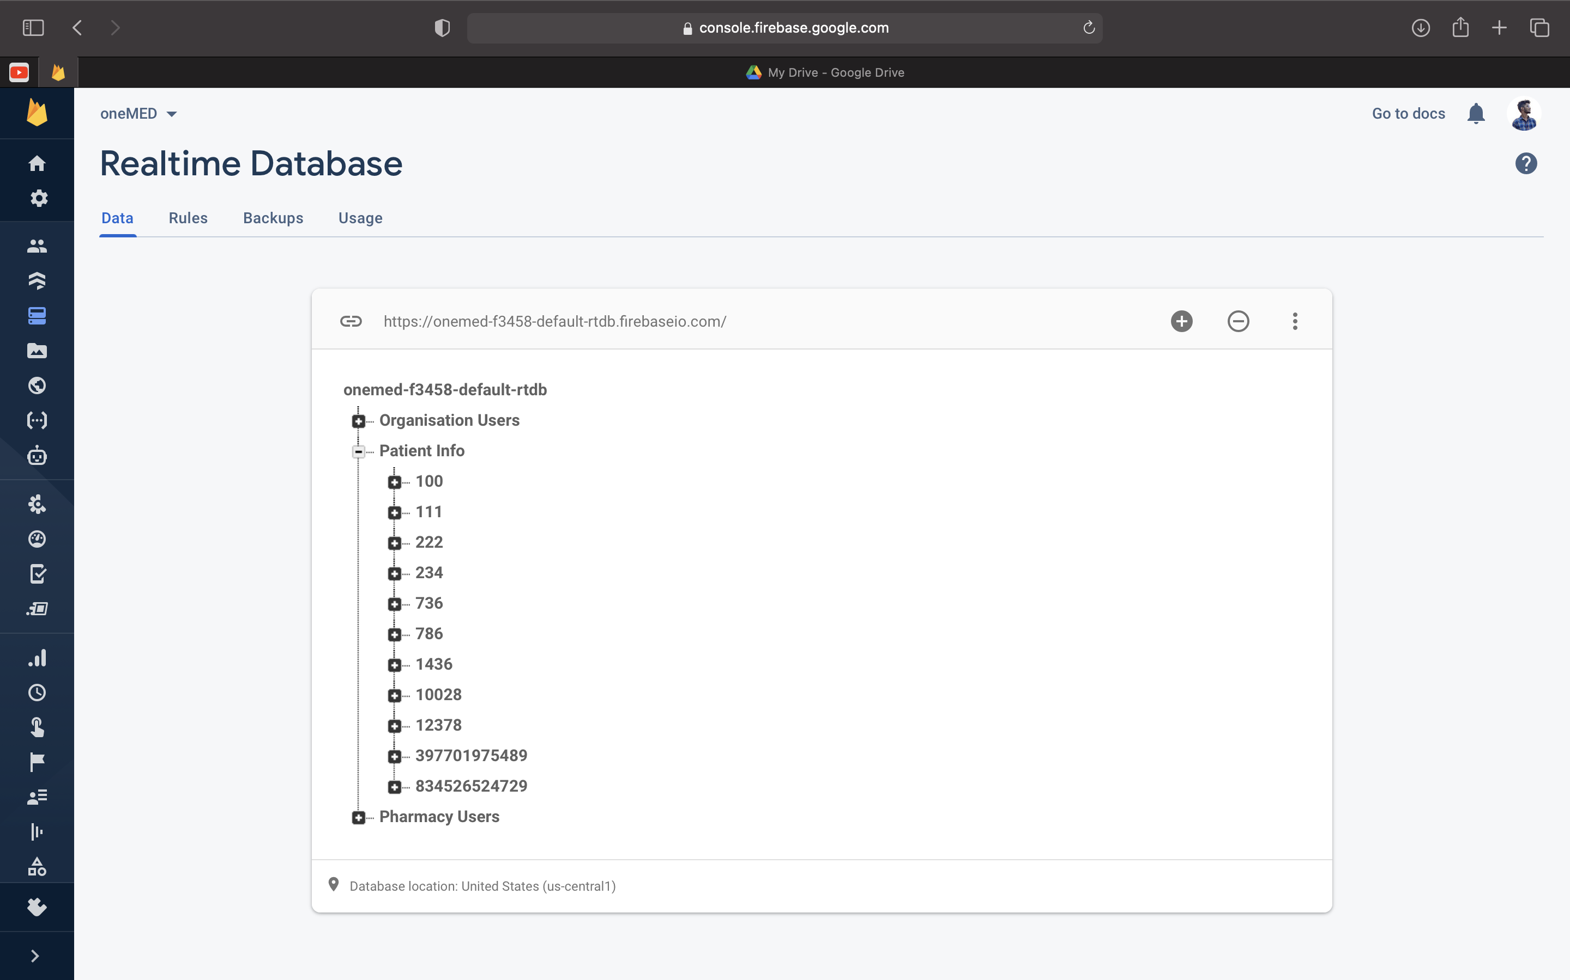
FireBase Realtime Database:
In this project we need to store the details of patients, doctor on cloud to access them on Realtime. So, we have used firebase database as a tool to send and receive the data from the cloud. This is a NONSQL database which means the data will be transferred in form of JSON. To include firebasedatabase in our project we need to include dependences to our build.gradle file.

Slide 16
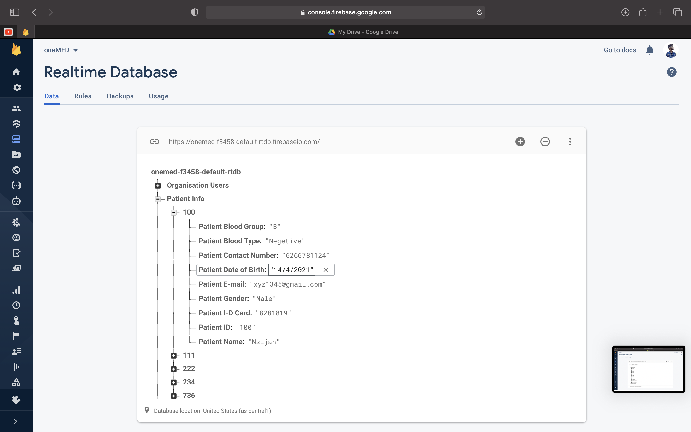
FireBase Realtime Database:
The Database can store three type of values i.e. the String, integer and long and has node and children where the data is stores and its efficient and updates realtime .The Firebase Realtime Database is a cloud-hosted NoSQL database that lets us to store and sync data between your users in realtime.

Slide 17
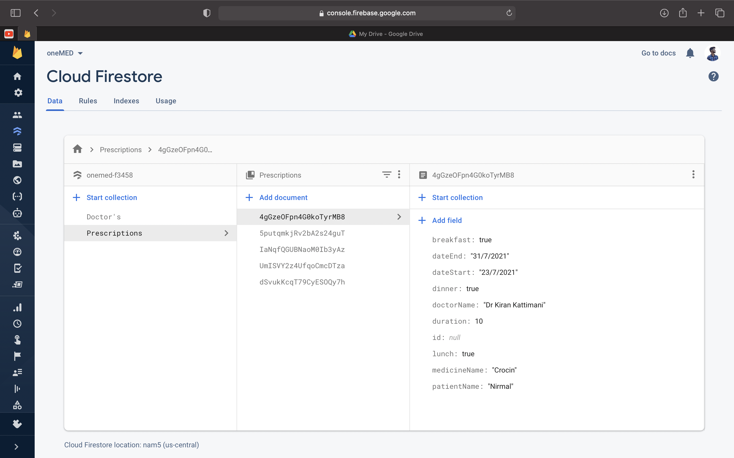
FireBase Cloud FireStore:

Slide 18
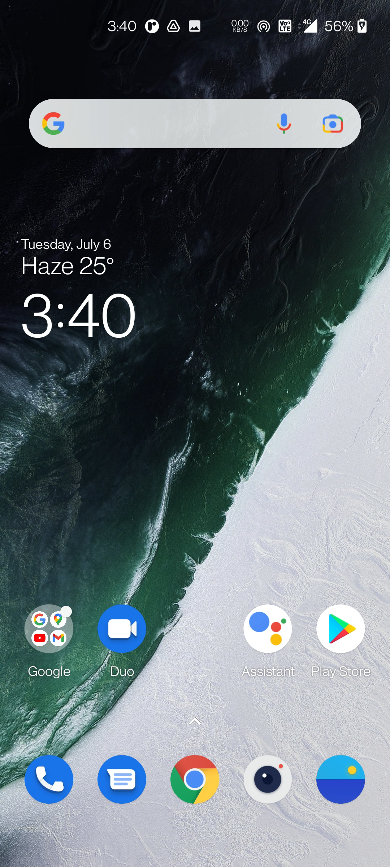

Slide 19
Experiments and future scope
The Future scope of this project would be implementing all the major activities that are performed in a hospital and would try to automate the process and minimise the pen paper work at the hospital. The future app development will include the Scheduling the appointment by the Patient and add the pharmacy where the user will be able to buy meds prescribed.Automate the patient records where the patient in his next appointment is not required to bring the previous prescribes meds or the health report as all that would be stored in cloud and can easily be accessed.

Slide 20
Sources and thank you

